Slide 1
Using Multiple Years of Truck GPS Data for Freight Model Development and Validation
17th TRB Planning Applications Conference
Colin Smith

Slide 2
Introduction
Motivation
Processing GPS data
Tour Typologies
Long Haul and Short Haul Connections
Conclusions
Notes:
The focus of my presentation is to explain techniques used to convert passively collected truck GPS data into information that can be used to support different types of analysis of truck movements.
I’ll begin by providing an overview of the motivation for the work,
Then discuss the processing techniques that we employed
Next I’ll focus on two applications of the data that we used to better understand truck operations
The development of tour typologies
And the approach used to identify connections between long and short haul trucks
Some of the techniques used are highly technical, but I’ll do my best to stay at a relatively high level and demonstrate the usefulness of these methods

Slide 3
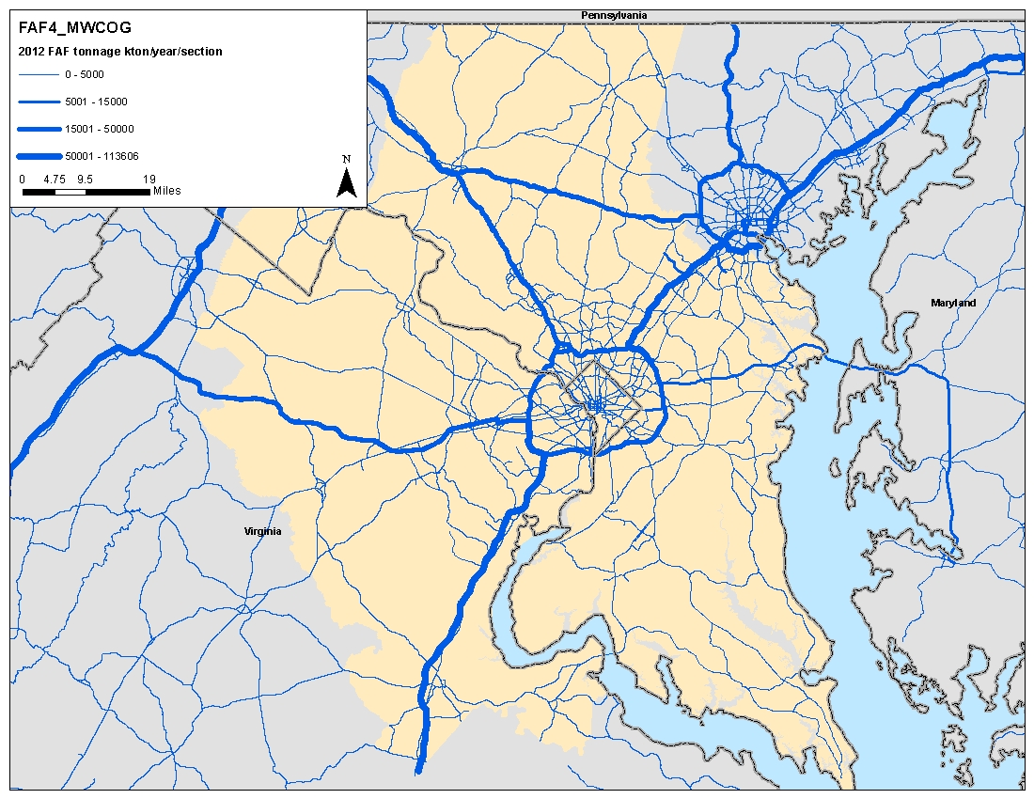
Motivation
Client requires a truck forecasting tool
Interested in both short and longer term truck travel behavior
Required that model be informed by local data
RSG proposed using passively collected GPS data (procured from INRIX) to develop an aggregate tour-based model
All steps of the modeling process informed by aspects of the GPS data
Model required to cover the Washington DC region
Notes:
The focus of my presentation is to explain techniques used to convert passively collected truck GPS data into information that can be used to support different types of analysis of truck movements.
I’ll begin by providing an overview of the motivation for the work,
Then discuss the processing techniques that we employed
Next I’ll focus on two applications of the data that we used to better understand truck operations
The development of tour typologies
And the approach used to identify connections between long and short haul trucks
Some of the techniques used are highly technical, but I’ll do my best to stay at a relatively high level and demonstrate the usefulness of these methods

Slide 4
Processing GPS Data

Slide 5
Processing GPS Data
Objective of processing GPS data is to convert sequence of individual “pings” – a time and location stamp recorded by a GPS device on the truck - into useful data
Depot: where the truck starts and ends each day
Stop locations: where the truck stops, e.g., to make deliveries
Trips: movement between stops
Tours: sequence of trips and stops over the course of the day
Notes:
The crux of our work on this project was to process the GPS data into useful information.
While some data vendors offer preprocessed datasets, in this case we chose to process the raw data provided by INRIX. This allowed us full control over the analysis and the ability to provide our client with a clear understanding of how the data were analysed. That is of course not to say that preprocessed data can be valuable – it is certainly a complex endeavor to manage and analyze these very large datasets
The raw data is essentially a list of what we call pings. Each time a GPS device records a location at a specific time, that ping is added to the dataset. So, as the truck with an onboard fleet management and routing device travels through the region, it gradually build a list of locations with time information.
The objective of the processing task is to take that list of locations with time information and convert them to a summary form. What we want to know to model trucks is where they start and end their day, where they stop, and how they connect those locations through trips and tours.
Before I go further, I’ll stop and explain those terms just so we are all clear on what they mean.

Slide 6
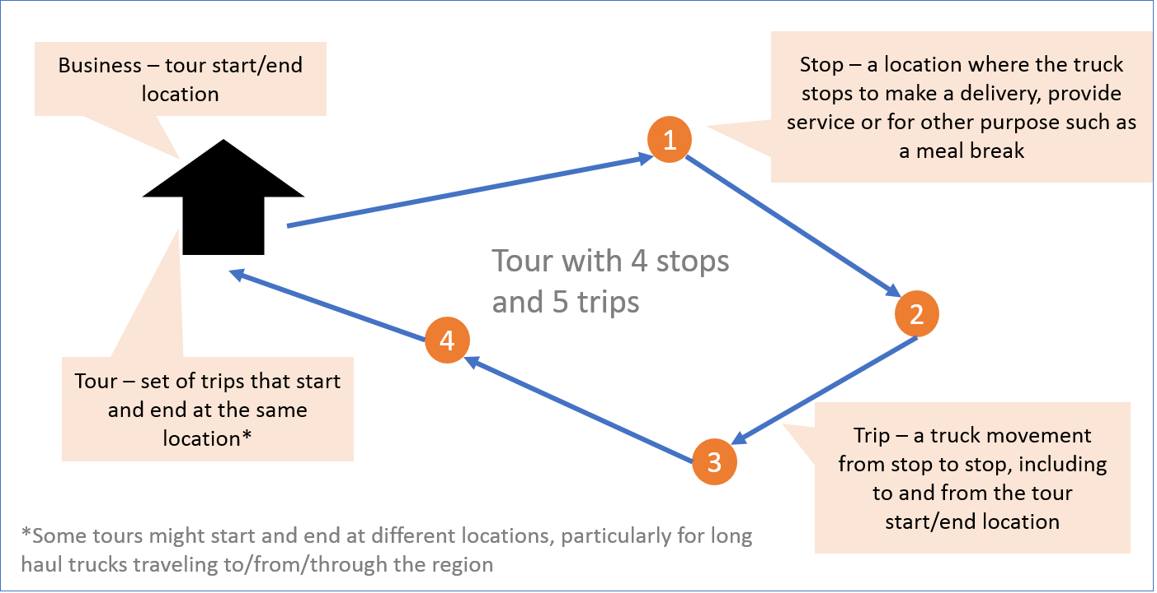
What are Depots, Stops, Trips and Tours?
Notes:
Hopefully this diagram explains things.
On the left, the house symbol is the business where the truck starts and ends its travel. This is often referred to as a depot.
In this case we are looking at a truck that has to make four deliveries. It heads out to the first delivery location and makes what we call a stop.
While I said four deliveries, trucks also stop for other purposes. Some make stops to provide a service. For example, a building contractor might drive his truck to your house and do some construction work. Or a driver might stop for a meal break or to refuel. We’ll discuss those other types of stops later.
The linkages between stops are the trips. In this diagram, we have four stops and five trips. 3 trips are between stops, one is from the depot to the first stop, and the final trip is back to the depot.
The whole circuit of trips is called a tour. When we think about modeling this behavior, we are describing a tour-based model – it is one that represents the sequence of trips as opposed to treating all of the trips independently.
I’ll use those terms: depot, stop, trip, and tour throughout the rest of the presentation.

Slide 7
About the Raw Data
Each device records location approximately every minute
Most trucks have multiple days of data
Dataset included two weeks of data from each of 2015 and 2017 for any truck in the sample that moved within the model region
Provider label | Weight class | Unique devices | Ping count | Median ping frequency (sec) | Mean active time (hr)
a | Medium | 375 | 98,689 | 30 | 97.1
b | Medium | 365 | 501,551 | 33 | 201.7
c | Medium | 1,611 | 505,255 | 60 | 197.2
d | Medium | 6 | 1,024 | 248 | 218.7
e | Heavy | 80,118 | 23,865,934 | 60 | 6.9
f | Medium | 21,330 | 19,178,690 | 90 | 193.9
g | Medium | 678 | 267,855 | 61 | 146.8
h | Medium | 1,793 | 1,022,720 | 120 | 200.9
i | Medium | 501 | 173,252 | 120 | 129.4
j | Light | 285 | 4,222,640 | 11 | 304.5
k | Light | 440 | 1,110,019 | 6 | 162.6
l | Medium | 3,869 | 1,861,037 | 107 | 165.7
m | Medium | 48 | 15,860 | 76 | 144.6
n | Medium | 50 | 7,600 | 121 | 37.0
o | Medium | 8,559 | 6,184,398 | 93 | 195.1
p | Heavy | 12,719 | 1,949,775 | 290 | 107.2
Data aggregated from multiple sources
Covers light, medium and heavy trucks
Thousands of unique trucks
Millions of individual pings
Notes:
The first point I’d like to cover is the magnitude of the raw data. This is one of the key benefits of these type of data. When we do truck diary surveys, the datasets that are extremely expensive to collect are measured in the hundreds of truck and a few thousand trips.
In this dataset
We have coverage of light, medium, and heavy truck
The dataset contains multiple sources, such as different fleet operators and onboard device types
There are many thousands of unique trucks represented
They reported millions of individual pings over the course of the 4 weeks of data
The frequency of ping is important. In generally there is a record around every minute for each truck, although that varies from every seconds to every 3 or 4 minutes.
One thing that is important for understanding the patterns of truck travel is to collect a good amount of data from each truck. In this dataset we often have many days worth of information about each truck. That helps with, for example, locating their typical start and end location for their day’s travel.

Slide 8
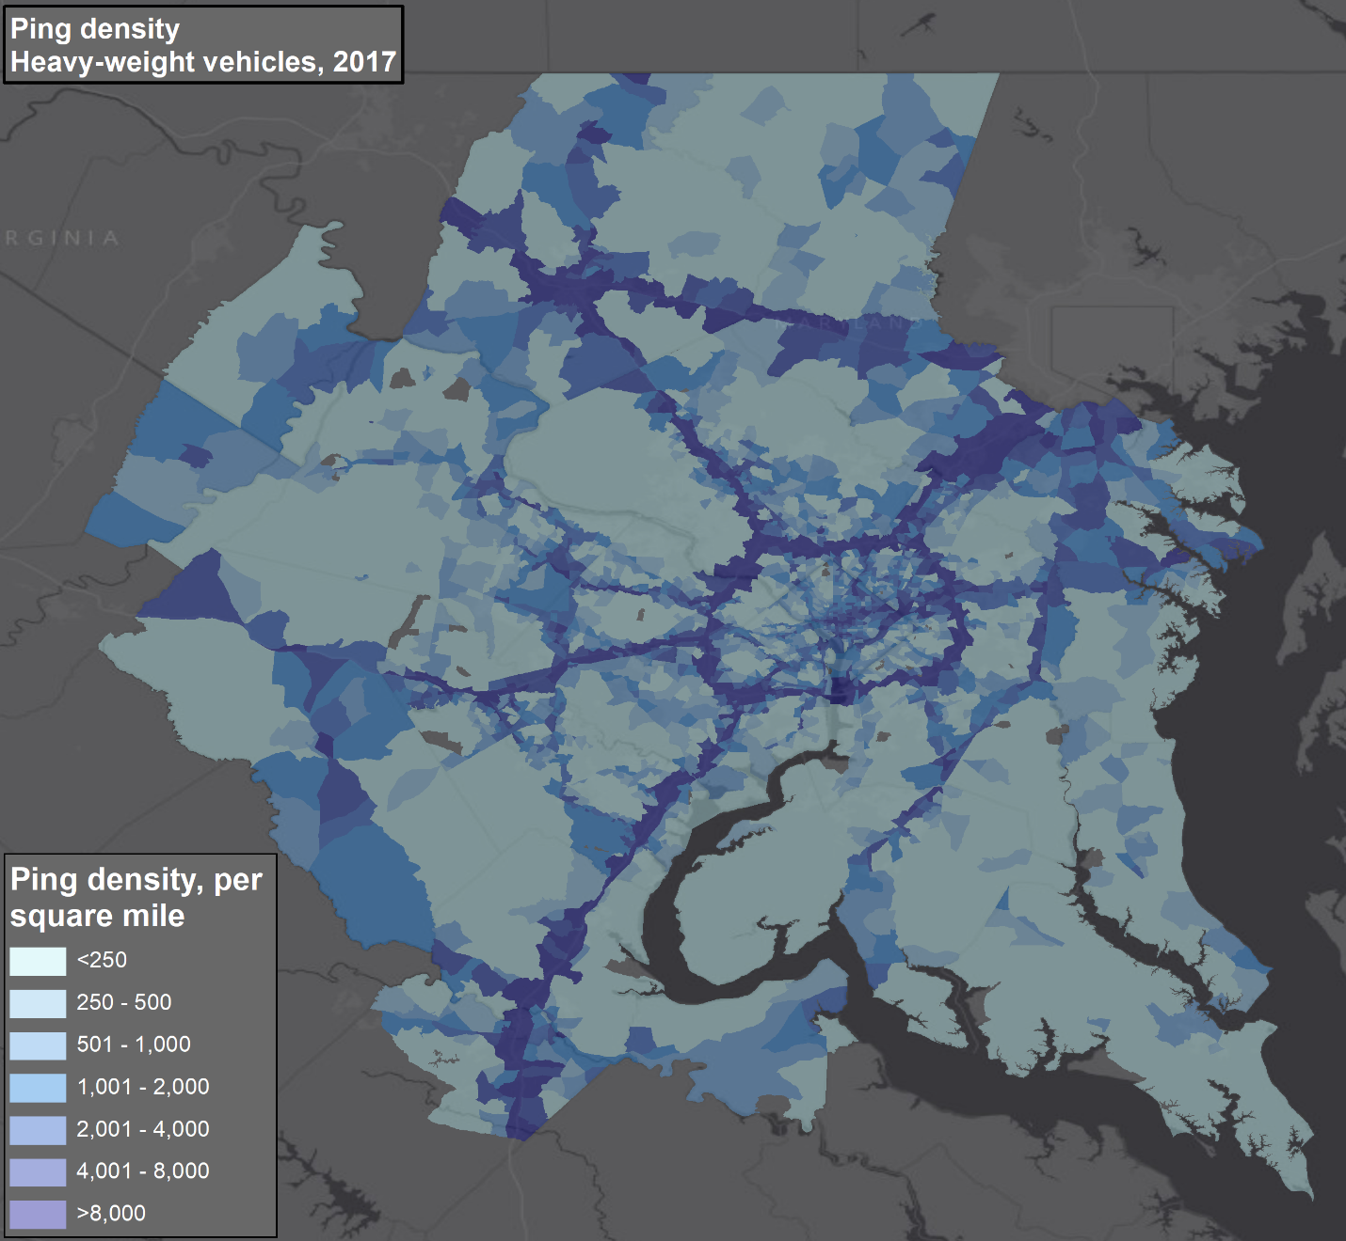
Raw Data: Heavy Trucks
Heavy truck data densest along highway corridors
Notes:
The spatial patterns of the truck pings are obviously important. In initially checking the data we want to see patterns of ping locations that make sense. And fortunately, these do.
As I mentioned, the dataset includes light, medium and heavy trucks.
We’d expect the spatial patterns exhibited in the data to conform to our expectations about the way different size trucks are operated
Heavy trucks are essentially tractor trailer combinations. Your typical long haul truck
And the spatial pattern shown on the map makes senses in that context. The darker colors on the map indicate a higher density of pings – i.e., where there is more truck travel.
We see clearly highlighted corridors like I-95 and the beltway around Washington DC. We see relatively little travel in the more rural areas of Virginia and Maryland, but also relatively little travel by heavy trucks in the center of DC either. We do see a notable concentration between DC and Baltimore in what is an important area for distribution and warehousing.

Slide 9
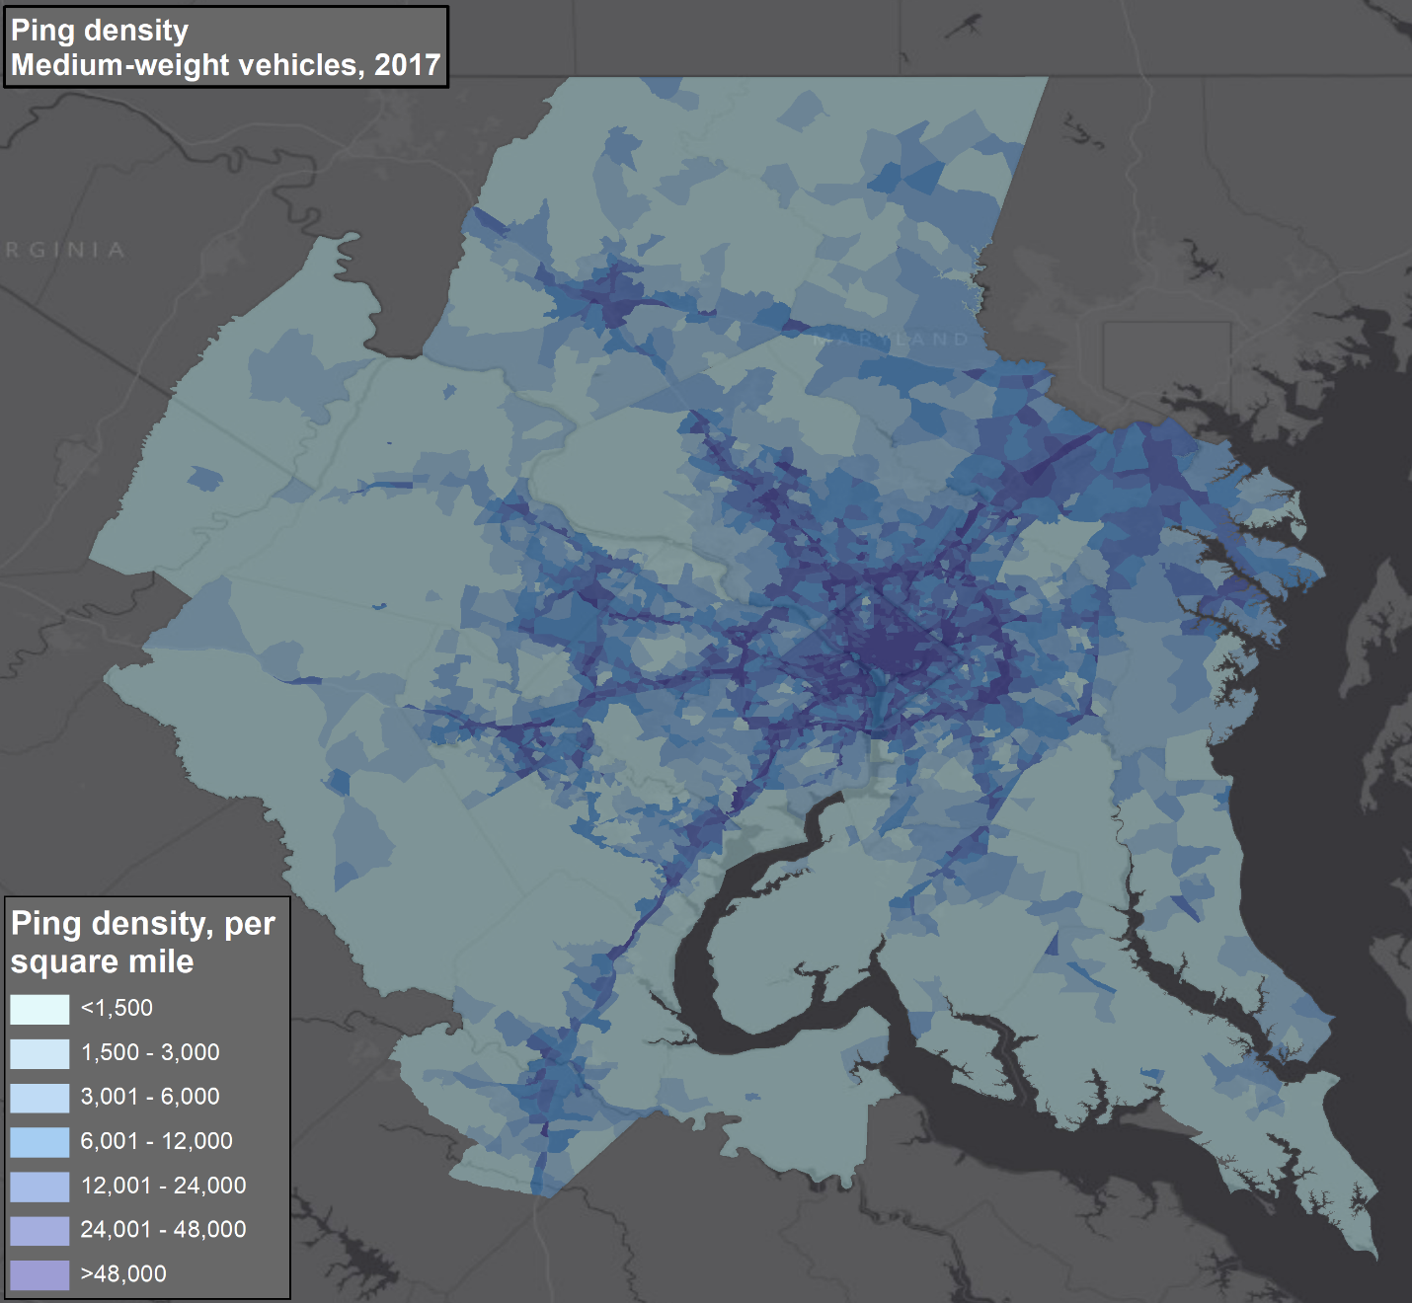
Raw Data: Medium Trucks
Medium truck data denser in urbanized areas
Notes:
When we switch to medium trucks, the travel patterns change somewhat
Medium trucks are single unit trucks and are more generally used for local distribution and delivery
Here we see the highway corridors becoming less prominent. Likewise, the urban areas are more prominent, showing that much of the medium truck travel is within the metro areas.

Slide 10
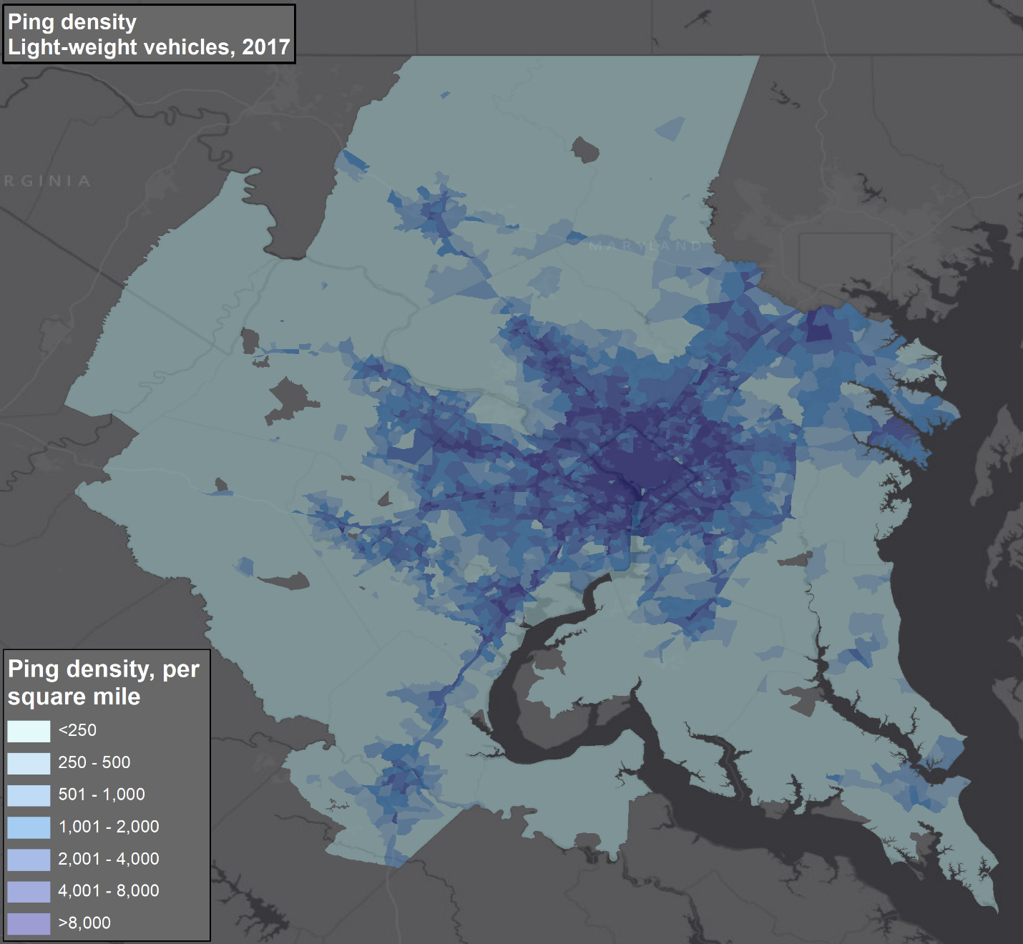
Raw Data: Light Trucks
Light truck data very dense in urbanized areas, relatively little on highway corridors
Notes:
Finally, the dataset includes light trucks.
Again, these are single unit trucks, but in this case are lighter vehicles, like single rear pickups and box vans.
You’ll notice that the highway corridors away from the metro areas almost disappear, with very high density of truck movements in and around the denser, urban areas of the region.
So, what we’ve seen is certainly promising – the data reflect the expected distribution amongst truck types in terms of where we should see them doing most of their travel.

Slide 11
Processing Steps
Pings within a highway buffer were tagged
Intermediate stops in truck stops, service stations, rest areas, and weigh stations were tagged
Dwells of greater than 7 or more minutes not in the highway and not at intermediate stop location were tagged as stops
Database was collapsed into a trip list
Notes:
Now that we’ve investigated the raw data, I’ll move on to an overview of how the data were converted into trips.
This data processing pipeline includes extensive geoprocessing of the data. I’ll illustrate some of this but not dive too deep into the details.
As we saw on the maps, many of the pings show the truck traveling along a highwau corridor. The first step in the processing is to mark each ping that we think is the truck traveling along a highway. That is done by buffering the roads in the region and looking for all pings that fall within that buffer.
Secondly, we want to look for stop locations that are likely to be what we call intermediate stops. These are not for the purposes of making deliveries or pickups, but for things like rest stops and refueling.
We identified those locations using databases such as the EPA’s underground storage tank databases. The ping that’s were found in those locations were also tagged.
Then we are left with a series of data that is off the highway and not at rest areas. In amongst these records we look for times when the truck dwells. The dwell we are looking for is around 7 minutes, although that is dependent on the truck – if it is recording pings very frequently we can use a slightly shorter dwell of say 5 minutes.
If the truck does dwell in the same place for more than 7 minutes and its not on a highway or in a rest area, we’ve found a stop. We do this for the whole dataset and then collapse the data into a list of trips, from stop to stop.

Slide 12
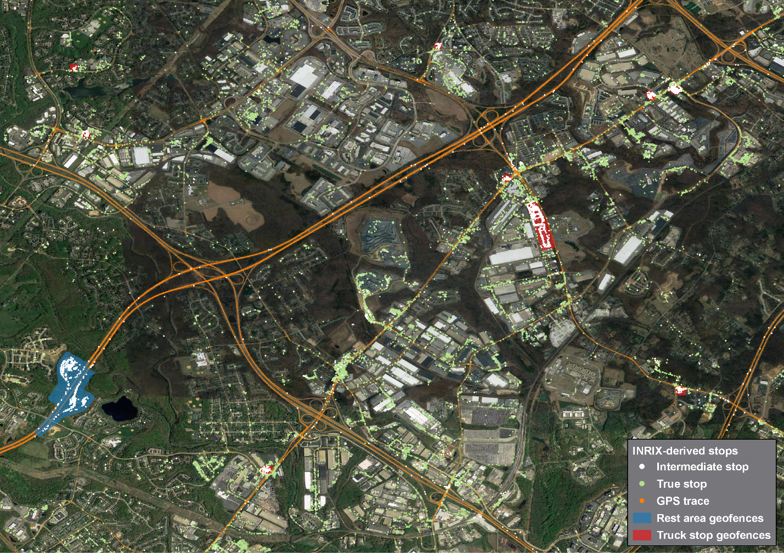
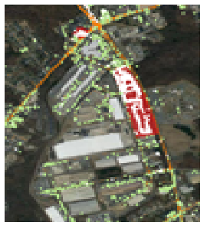
Intermediate stops in a truck stop
True stops at distribution centers and other businesses
Notes:
Here I want to show you what the looks like. We see in orange traces of GPS data along the roads and then point in and around buildings in the region.
<animation – show zoom in.
If we zoom in on one area, we see two types of locations
The red box is one area that we’ve identified as a truck stop from the database of truck stop locations
The white dots show stops with the boundary of the rest area
The green dots show the stops outside of the highway and away from rest areas. Those are generally clustered around large flat roofs – at delivery docks for example at distribution centers and other businesses. This visual confirmation is helpful
One thing we do see particularly for smaller trucks is that some stops are on smaller roads (as opposed to highways) – those would be for example parcel delivery trucks stopping in residential neighborhoods. We don’t want to remove every stop from a roadway, just stops on more major roads where stops are mostly likely to be just stops at intersections and in traffic congestion.

Slide 13
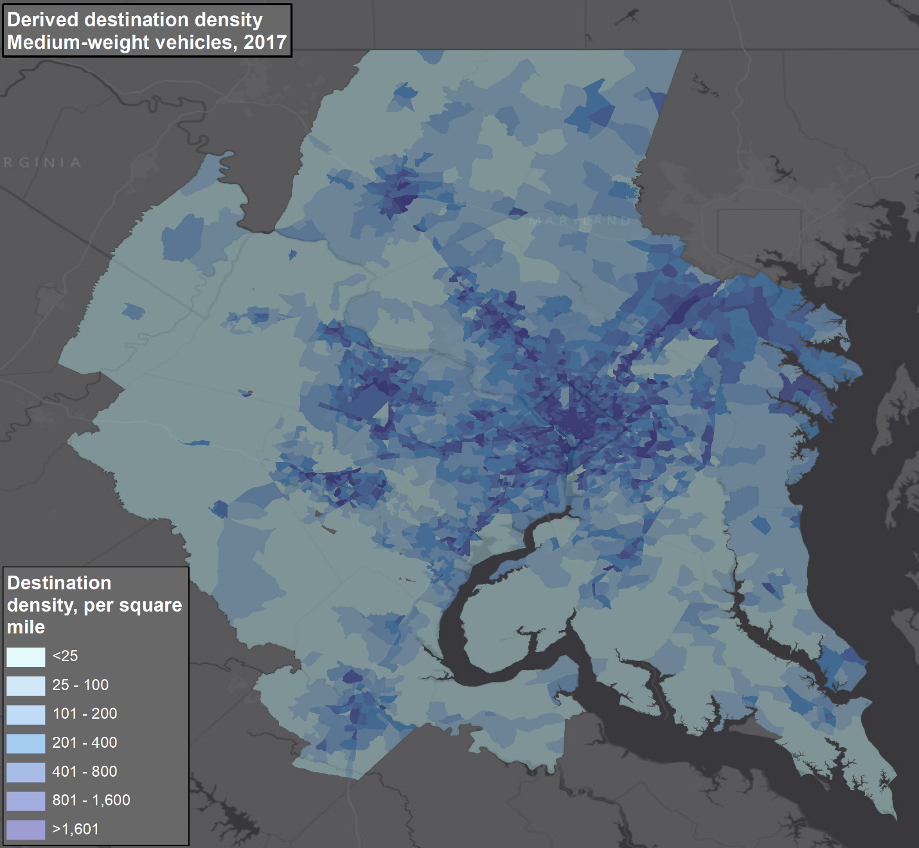
Medium Truck Trip Destinations
Visualization of the medium truck trip table
Notes:
The product of these processing steps are trips tables. Separate trips from zone to zone across the region. This in and of itself is a useful planning product.
The map shows the medium truck trip destinations. The highway corridors that were more noticeable in the ping data are less obvious as we would expect. The major urban areas stand out as do the intraurban corridors where there is significant freight intensive development like manufacturing and distribution.

Slide 14
Depot Identification
For a tour based model, we want to know about the truck’s depot – where it usually starts and ends a work day
Short haul trucks (those that generally stay inside the model region) identified from the trip dataset
Identify locations repeatedly visited by the truck
Clustering algorithm combined with graphing to look for tour start and end points
Weighted higher those locations that are common to multiple trucks
Notes:
One of the unique analyses that we continued to in this study is depot identification.
As I mentioned, the representation of tours in a model requires that we understand where trucks begin and end tours, and most importantly where they begin and end their daily travel.
This depot identification step was comprised of a few steps:
First we are really interested in looking at short haul trucks – those that travel within the region and tend to start and end their day in the same locations. This is different that long haul trucks which can travel on multi day trips and may not start and end a travel day in the same place.
The approach focuses first on identifying all of the locations that each truck repeatedly visits. These could be depots, but they could also be regular delivery locations
Then we sequence the travel of a truck together to connect trips together into tours and select those frequently visited locations that form tour start and end locations
Finally, in the identification process we look at places where multiple trucks start and finish tours. Those we can more confidently say are depots.
Ultimately we process the data to identify the thousands of depot locations across the region.

Slide 15
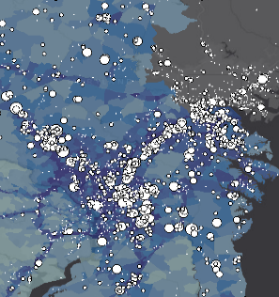
Medium truck depots
Locations of medium truck depots
Notes:
I’m going to show an example of identifying the depot locations of medium trucks. The maps shows depots in DC to Baltimore corridor, to the east of DC, and to the northwest along I=70. The general pattern of locations conforms to where much of the industrial development is in the region.

Slide 16
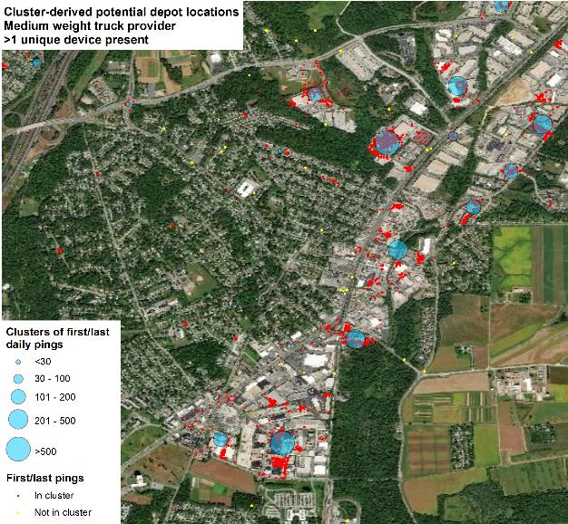
Stop locations that met the criteria tagged as depot locations
Notes:
We’ll zoom in on one particular business area.
While we have many clusters of stops, only some are identified as depots.
The red stops show locations where many trucks stop. We’ve overlaid blue circles where there is a depot. Obviously some businesses attract a lot of truck activity, but do not represent truck depots. For example, a retail outlet like a grocery store might have a lot of deliveries and show up as a cluster, but those are stops during the course of the trucks travel each day.
The depot identification process helps to separate those types of locations from the depots where trucks are beginning and ending their day’s travel.

Slide 17
Processing Summary
Raw ping data of 142 million records from 283,000 trucks
Processed into 2.7 million trips (representing a total of ~ 3.5 million miles of truck travel)
Expanded and scaled to daily trucks using traffic counts, resulting in ~1 million daily trips
Approximately 64,000 unique depot locations identified
Notes:
So at the end of the processing steps we have created a very powerful and rich dataset.
We took 142 million pings from 283,000 trucks and converted it into 2.7 million trips. That represents 3 and a half million miles of truck travel in the region
The expansion process, which I didn’t describe, converts the sample of 2 weeks of travel in each of the two years of data to a daily truck trip table. That results in a trip table for each year of around 1 million daily trips covering the region.
And finally, we found 64,000 depot locations.

Slide 18
Tour Typologies

Slide 19
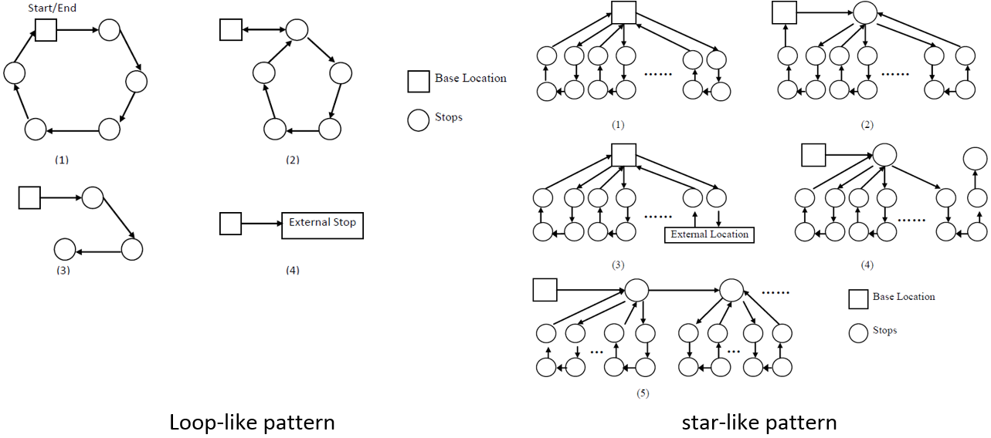
Tour Typologies
In the literature, there are several papers suggesting tour typologies, often based on relatively small data samples
In this study, we used the dataset to segment truck travel into five tour types
Each segment is them modeled separately
Notes:
I’m going to move on now to describe two further analyses that we did to better understand how trucks travel and to support the development of the tour-based truck model.
The first is to search the data and identify tour typologies. By that I mean the different types of tours that trucks make.
In the literature there are several papers suggesting different tour typologies. In this study we were able to develop 5 tour types and model each of those separately.

Slide 20
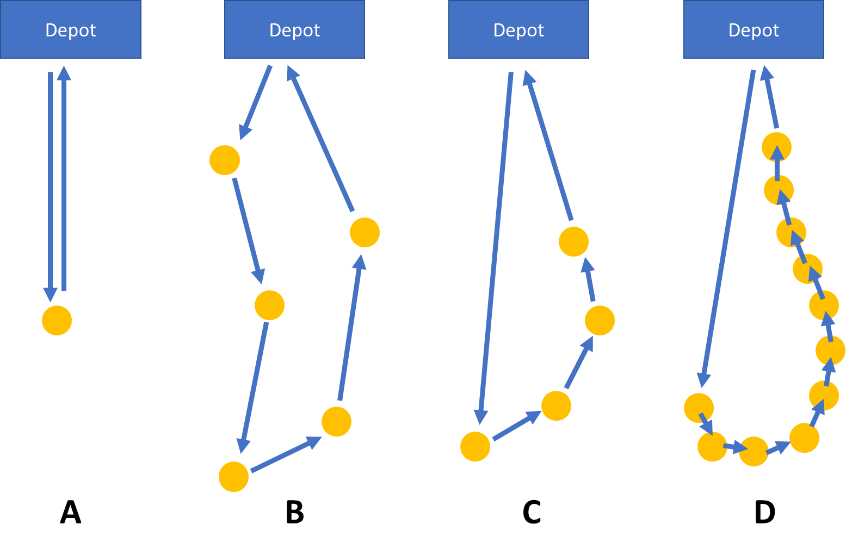
Tour Typology Identification
No stops between depots: depot to depot tours
A: Single stop: single stop tours
B: Long trips between stops: multi-sparse stop
C: Short distance between stops: multi-clustered stop
D: Large number of close stops: many-short-trip clustered stop
Notes:
We identified the tours using a combination of looking at the type of stop locations, counting the number of stops, and seeing how far apart the stops were.
First, we looked at trucks that just traveled from depot to depot. You can think of these as an example of long haul or regional distribution – large trucks going from point to point in a supply chain.
Then we looked at the depot based tours that includes stops at other locations.
First we separated out single stop tours. That is obviously expected to be a common tour patter. For example, a full truck load delivery would see a truck leaving its depot, making the one delivery, and returning to reload.
After that we separated the multi-stop tours into three classes.
Some trucks have relatively widely spaced stops – we called this a sparse tour. This might be for example, a truck servicing the multiple outlets of a business across a region, or making furniture deliveries to a range of customers over a day.
Then there are two final types of tours with clustered stops. If there were relatively few stops but they were clustered together, the tour was called a multi stop cluster. You might see this with a truck making deliveries to closely located customers in a metro area.
When there were many stops, such as along a route, the tour was called a many short trip clustered stop tour. Parcel delivery and waste collection are two types of operation that would typically follow this pattern.

Slide 21
Tour Typology Distribution
Over 80% of heavy truck tours are depot to depot or single stop
Light and medium trucks have a larger proportion of multi stop tours, particularly “sparse” tours
Relatively few trucks are making multi-stop clustered tours, those that are are generally light and medium trucks
Tour Type | Heavy | Medium | Light | Total
Depot | 30.49% | 20.55% | 15.41% | 19.00%
SS | 53.33% | 43.99% | 47.43% | 46.15%
MSS | 13.94% | 29.74% | 31.54% | 29.41%
MSC | 0.35% | 3.77% | 4.40% | 3.80%
MSSC | 1.90% | 1.96% | 1.21% | 1.63%
Total | 100.00% | 100.00% | 100.00% | 100.00%
Notes:
We were able to identify the prevalence of each tour type. Here they are tabulated by truck size
There are some clear differences in the shares of tours made
Heavy trucks have the highest proportions of depot to depot tours and also single stop tours
Light and medium trucks are more likely than heavy trucks to make multi-stop tours
Most tours are of the “sparse” category, which means the stops are spaced apart.
While very few heavy trucks make tours with clusters of stops, around 6% of light and medium truck tours are of this type. While 6% isn’t a huge number, because they make many stops they account for a lot truck activity.
This table in particular is an important finding from this study, and one of the first large scale segmentations of truck travel into tour types by truck type.

Slide 22
Using Segmented Data to Support Model Estimation
Data processed into tours and segmented by truck type and tour type
Used to estimate tour generation, stop generation, and destination choice models
Captures the characteristics of the different tour types
Short Haul Model: Tour Generation
Short Haul Model: Truck Stops
Depot Based Destination Choice
Non Depot Based Destination Choice
Notes:
Once we’ve segmented the data into truck tours types by truck type, we developed a system of models to represent that travel and that is then sensitive to changes in the region, such as changes in employment locations and travel times.
The model sequence first estimates the number of tours by type and truck size generated in each zone
Then the model estimates the number of stops made by trucks on each tour type
Then the model use destination choice models to link the stops together.
First the model predicts the destination of the outbound trip from the depot
Then the model predicts the locations of subsequent stops.
The result is a representation in the model of the five tour types by each of the three truck sizes.

Slide 23
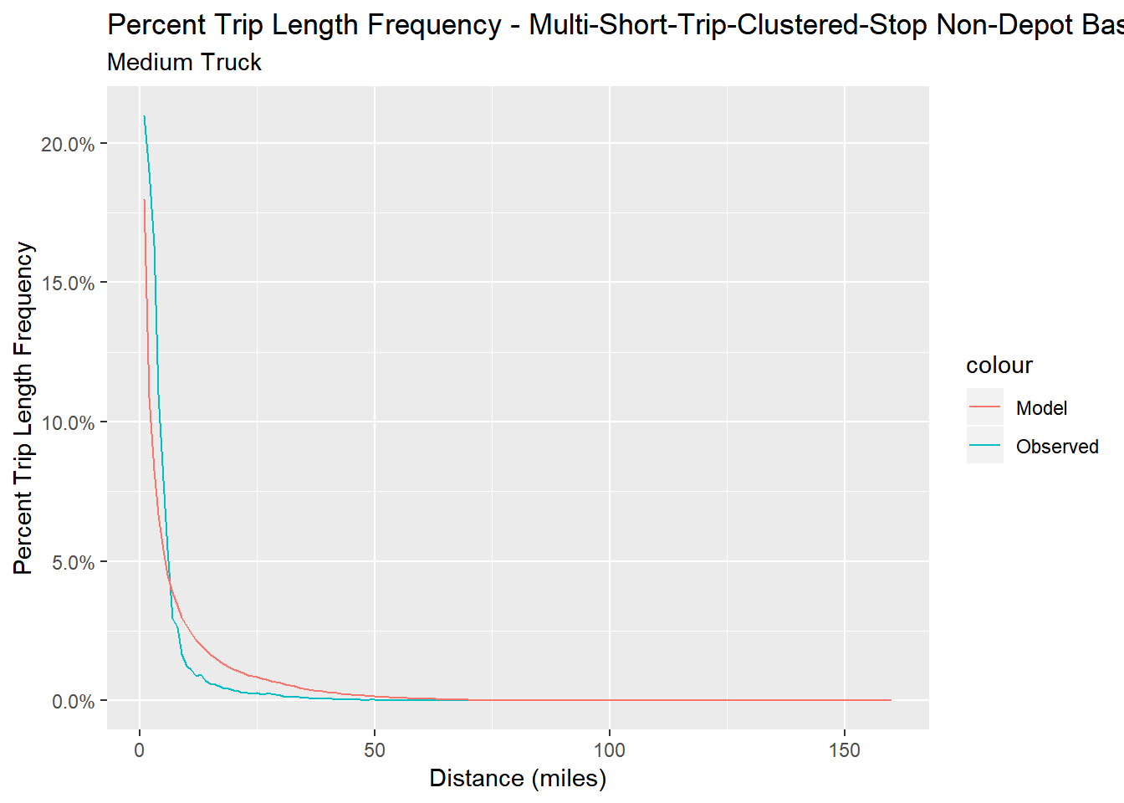
Example: Destination Choice
Model should reflect trip lengths by segment:
Sparse tours have longer trips,
Tours with clusters have short trips
Trip length frequency shows the model replicating the very short trip lengths between stops in the tours with closely clusutered stops
Notes:
The model should reflect the characteristics of these different segments. For example, the sparse tours should have longer trips than the clustered tours. And that happens
The chart shows the trip length distribution of the trips between stops on the multi-stop clustered tours
You’ll note that the distribution in both the observed data and the model is skewed towards very short trips.

Slide 24
Connecting Long Haul and Short Haul Truck Movements

Slide 25
Long Haul and Short Connections
In theory, a freight model should connect long haul and short movements.
Long haul movements to and from a region provides demand for short haul truck movements
However, historically it has been hard to comprehensively identify the connection locations between those flows and understand how they operate without extensive survey work
In this study, we used the processed GPS data to identify high activity truck locations
Classified them by truck type and by quantity of short and long haul trip
Identified transshipment locations where long haul flows and short haul flows meet
Used this to inform short haul truck tour generation based on commodity flow forecasts at these locations
Notes:
We know that this connection exists in theory. As freight moves through supply chains from producer to consumer it is transshipped. This often occurs at a transition from national long haul movements to local distribution at locations around metro area.
Identifying those locations and understanding their business behavior is not straightforward. We can see on aerial photos the likely locations of such facilities. However, we historically would need to survey or otherwise collect data on the individual business operations at these facilities. A location that is primarily longer term warehousing may appear relatively similar to a location that is much more intensively used by trucks.
In this case, we were able to categorize locations as high activity trucking locations. And furthermore categorize them as those where long haul trucks from out of the region made visits along with short haul trucks serving within region activity.
The combination supported modeling connections in the model system where short haul tour generation was influenced by long haul activity.

Slide 26
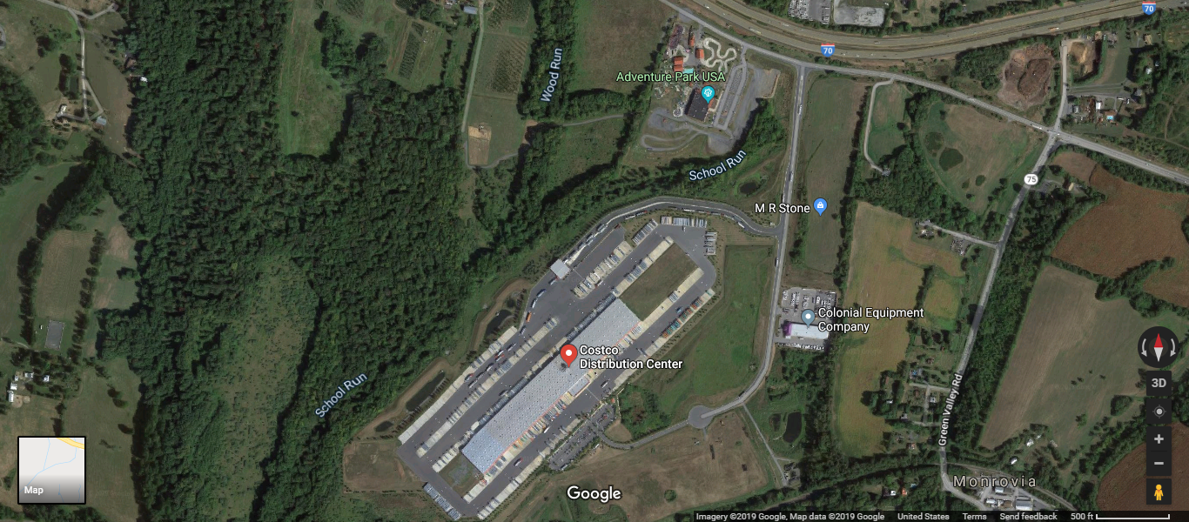
Example Location 1: Costco
Costco distribution near Frederick, MD is one of the highest intensity locations in the region for both long haul and short haul (within region trucks)
Relatively low employment on site means it does not stand out using more traditional employment based truck trip rates
Notes:
I’ll show example of two locations flagged by this process.
The first is a major distribution facility for Costco. This stood out over and above the employment data for the region as a significant generator of truck travel, both long haul and short haul.
That illustrates an issue with relying on employment for travel modeling. In many cases, these types of facilities are becoming increasingly automated and may not employ many people. Truck trip rates based on employment are not necessarily a reliable indicator of activity.

Slide 27
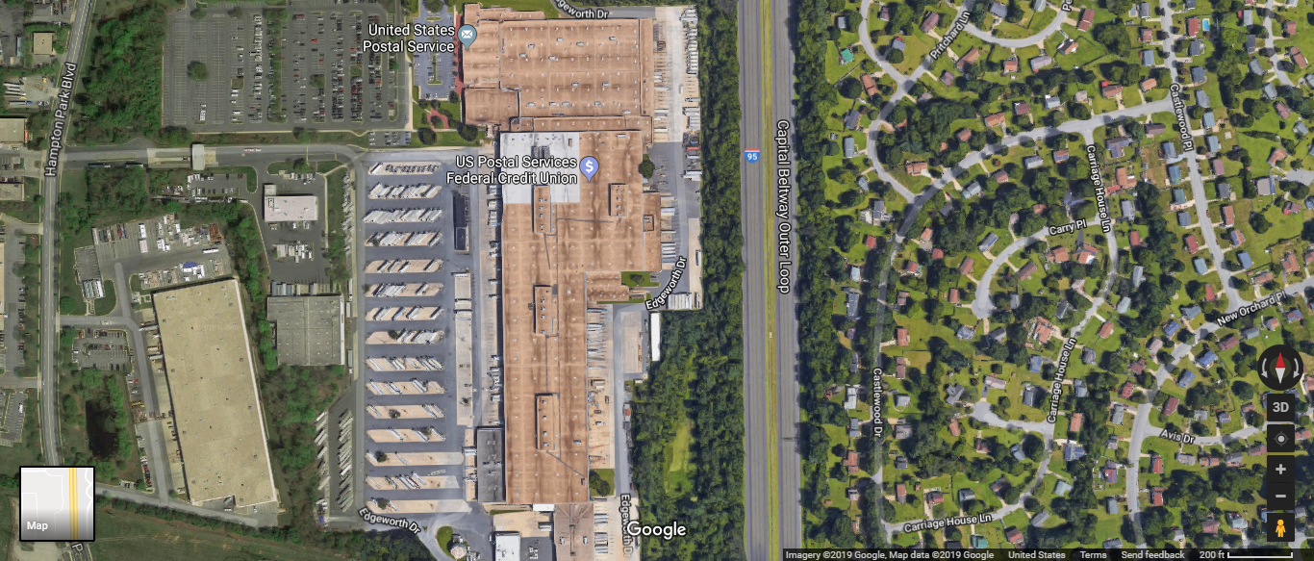
Example 2: USPS
US Postal Service depots are also important interchange locations between long haul mail movement and local distribution.
Two major USPS depots (including this one by the beltway) stood out in the GPS data and are represented in the model as special generators
Notes:
The second example flagged in the data is a United Stated Postal Service depot. This another good example of where long haul mail trucks connect into the local mail distribution system.

Slide 28
Conclusions
Large sample truck GPS data can be used to develop an understanding of truck travel behavior
Processing techniques allows for creation of trip tables, tour lists, and depot identification
Trucks can be categorized by tour typologies to segment truck operating practices
Linkages between long haul and short haul movements can be observed region-wide and modeled
Notes:
There is still much were are learning from the data on this study, but I’ll stop here.
Some key takeaways I’d like to leave you with:
We demonstrated that a large sample of truck GPS data can be used to develop a detailed picture of truck travel in a region
Processing techniques exist to convert raw GPS data into more usable forms, such as trip table, tour lists, and that we demonstrated advanced processing is possible where for example depots are identified
We showed how truck travel can be grouped into different tour types and that is a reasonable way to segment truck operating practices for travel modeling.
Finally, we also showed that it is possible to use these data to identify the locations at which linkages occur between long haul and short haul trucking.
Thanks for your attention!

Slide 29
Colin Smith
Director
Colin.Smith@rsginc.com

